Slide 1
Integrate EyeLink and MatLab

Slide 2
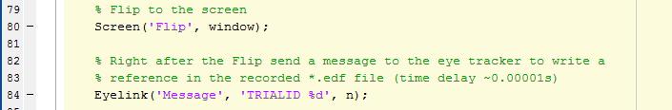
Code source
To integrate Matlab and the EyeLink we use resourses from PsychToolbox
http://psychtoolbox.org/
You need to install psychtoolbox and should be able to run it on the computer that you want to perform the experiment with
The code is created using examples already integraded in psychtoolbox:
~\Psychtoolbox\PsychHardware\EyelinkToolbox\EyelinkDemos\SR-ResearchDemo
This example code is simply separated in function to be easily applicable to your personal Psychtoolbox experiment
Contains functions:
SetUp_Eyetracker.m = sets initial variables and starts interaction between your presentation computer and the eye tracker host computer; initiates the fixation calibration of the eye tracker; place in a position in your script, short before you run the first presentations
Start_Eyetracker.m = tells the eye tracker to start recording; add in the moment you want to start recording
End_Eyetracker.m = end recording and shut down eye tracker; at the end of the presentation
Add comments and events to the recorded *.edf file, by just adding Eyelink(‘Message’, ’here you write your message’); at any location in your experimental script
There is an example experiment: Example_Integration.m it was obtained from http://peterscarfe.com/gaborarraydemo.html (27.02.19) and just added the provided eye tracker integration functions
Please consider: These are just fast but working examples to run the eye tracker on your experiment; Check out the EyelinkDemos folder for more fancy solutions; Modify the functions and run your personalized experiment; there are wayway more things you can do with it !
Example:

Slide 3
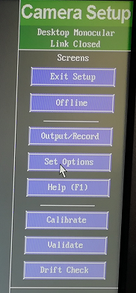
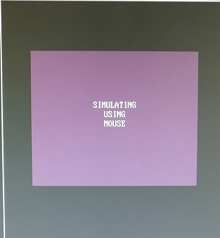
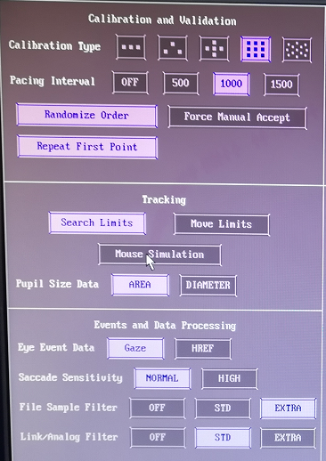
Tip
If you want to test your script and the eye tracker together, but you do not have a subject:
Use the „Mouse Simulation Mode“
Go to : Set Options -> click Mouse Simulation -> perform calibration/validation/experiment by using the computer mouse
Moving and clicking = Saccade / Hold left mouse button and moving = smooth pursuid

